Slide 1
SME Loan Pre-Screen:
Right-First-Time Applications
Submitted by:
Seema Parasar
Roll no: CU10
Cotton University

Slide 2
Introduction
Small and Medium Enterprises (SMEs) depend heavily on timely access to credit. However, the initial screening of SME loan applications often becomes slow, inconsistent, and error-prone when done manually. Loan officers must verify multiple documents, check applicant details, and ensure completeness before forwarding cases for appraisal—making the process both time-consuming and prone to oversight.
To overcome these challenges, this project aims to automate the pre-screening process using lightweight, easily deployable tools. By combining Google Sheets for data handling and rule execution with Google Apps Script for streamlined user interaction, the system ensures faster, more accurate, and right-first-time loan assessments without relying on heavy software or complex infrastructure.

Slide 3
Problem Statement
Traditional SME loan pre-screening relies on manual verification of applicant information and documents.
This approach results in:
High chances of human error
Delays in decision-making
Incomplete applications reaching the appraisal stage
Difficulty in maintaining consistency across officers
There is a need for a simple, automated, rule-based tool that can rapidly validate loan applications and ensure right-first-time completeness.

Slide 4
Objectives
To design a lightweight, automated SME loan pre-screen tool
To use Google Sheets as the backend for datasets, rules, and dashboards
To build a Google Apps Script-based chatbot for data entry
To classify applications into actionable categories (Ready / Hold / Reject)
To improve accuracy and speed of initial loan screening

Slide 5
Tools & Technologies Used
Google Sheets:
Dataset storage
Rule engine implementation
Automated dashboard with charts
Google Apps Script:
Custom menu
Sidebar chatbot
Automated entry form and decision logic
Document Flags:
KYC Document
Income Proof
Business Proof

Slide 6
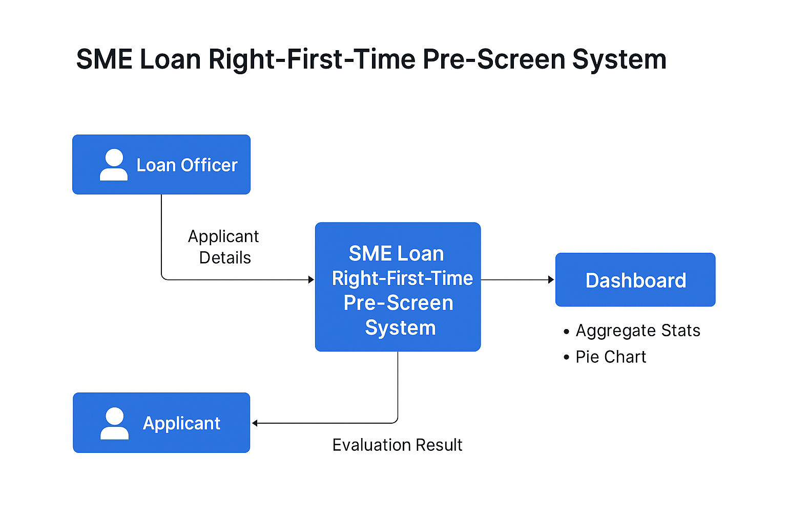
Context diagram

Slide 7
System Workflow
The loan officer opens the main Google Sheet.
From the menu: SME Portal → Open Chatbot.
The officer enters applicant details and document submissions.
Apps Script writes data to the dataset and triggers formulas.
Rule engine evaluates document completeness.
Final status is assigned automatically.
Dashboard updates with new statistics and charts.

Slide 8
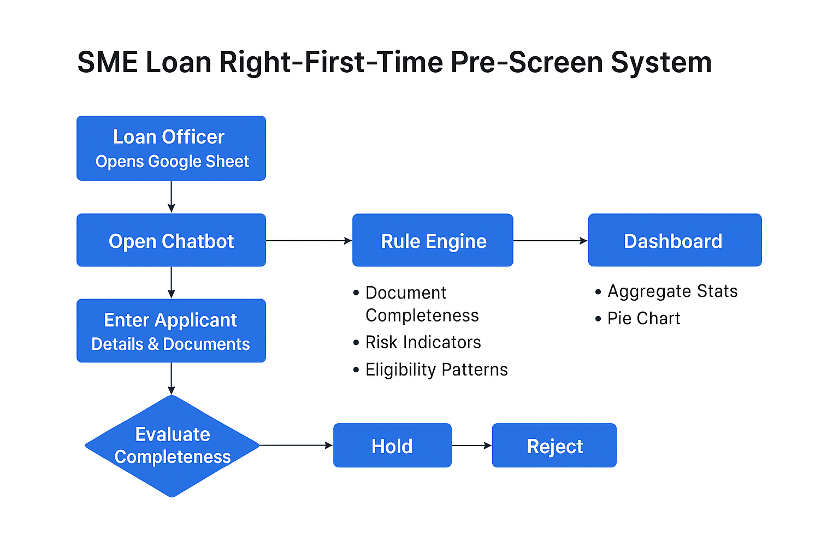

Slide 9
How the System Works
User enters Applicant ID, Industry, Loan Amount, and SME category.
Officer also selects whether KYC, Income Proof, and Business Proof are submitted.
Apps Script logs the entry into the Loan Application DataSet sheet.
Columns K–O (formula-based rule engine) evaluate:
  Document completeness
  Risk indicators (if any)
Eligibility patterns
System assigns one of the outcomes:
  READY FOR APPRAISAL
  HOLD
  REJECT
  BUSINESS PROOF NEEDED

Slide 10
Rule Engine Logic
The rule engine is fully implemented using Google Sheets formulas.
It evaluates:
Mandatory document availability
Category-wise eligibility
Minimum documentation compliance
Examples:
If all documents = YES → Ready for Appraisal
If Income Proof missing → Hold
If multiple required documents missing → Reject
If Business Proof only is missing → Business Proof Needed

Slide 11
Dashboard Overview
The dashboard provides a quick visualization of all loan applications:
Total applications submitted
Count of Ready / Hold / Reject / Proof Needed cases
Pie chart for status distribution
Summary metrics updated automatically after each entry
This allows officers to monitor workflow efficiency and identify trends instantly.

Slide 12
Files Included in the Project
Code.gs – Google Apps Script backend (menu, chatbot, rule engine trigger)
ChatbotUpload.html – Sidebar UI for data entry
sample-dataset.xlsx – Example dataset with predefined structure
dashboard.png – Screenshot of the dashboard
chatbot.png – Screenshot of the chatbot sidebar

Slide 13
Advantages of the System
Faster processing of loan applications
Reduced manual work and errors
Consistent and transparent decisioning
Google-based, no installation needed
Easy scalability and collaboration
Automatically updated dashboard

Slide 14
Limitations
Rule-based (no machine learning used)
Depends on correct user inputs
Limited to document completeness, not document authenticity
Works best only for SME loans, not complex loan cases

Slide 15
Future Enhancements
Integration of machine learning risk-scoring models
Automated document OCR-based verification
Multi-stage rule engines
Integration with CRM or Loan Origination Systems
Multi-user access controls
SMS/Email notification system for applicants

Slide 16
Conclusion
The SME Loan Right-First-Time Pre-Screen System successfully automates the early stage of loan evaluation using simple yet powerful tools. With Google Sheets as the rule platform and Apps Script enabling real-time data entry, the system provides fast, consistent, and error-free pre-screening. This improves operational efficiency and ensures that only complete, valid applications move to the appraisal phase.

Slide 17
Thank You

